Slide 1

Software Engineering Lecture # 2
Quratulain
Lecturer
Department of Computer Science

Slide 2
Course Objective
To familiarize students to the fundamental concepts, techniques, processes, methods and tools of Software Engineering,
To help students to develop basic skills that will enable them to construct software of high quality – software that is reliable, and that is reasonably easy to understand, modify and maintain
To foster an understanding of why these skills are important

Slide 3
Some Definitions

Slide 4
Software
Software is more than just a program code.
A program is an executable code, which serves some computational purpose.
Software is considered to be collection of executable programming code, associated libraries and documentations.

Slide 5
Software Product
Software, when made for a specific requirement is called software product.

Slide 6
Software Engineering
Software engineering is an engineering branch associated with development of software product using well-defined scientific principles, methods and procedures.
The outcome of software engineering is an efficient and reliable software product.

Slide 7
Software Engineering(Cont..)
IEEE defines software engineering as:
The application of a systematic, disciplined, quantifiable approach to the development, operation, and maintenance of software; that is, the application of engineering to software.

Slide 8
Software Evolution
The process of developing a software product using software engineering principles and methods is referred to as Software Evolution.
This includes the initial development of software and its maintenance and updates, till desired software product is developed, which satisfies the expected requirements.

Slide 9
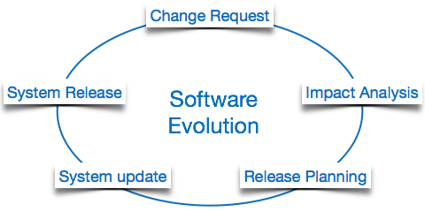
Software Evolution(Cont..)

Slide 10
Software Paradigms(Cont..)
Software paradigms refer to the methods and steps, which are taken while designing the software.
There are many methods proposed and are implemented.

Slide 11
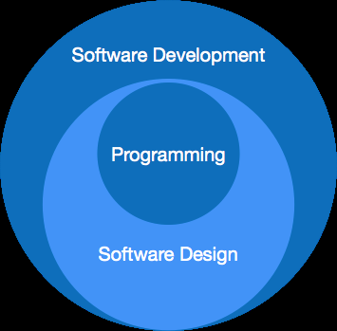
Software Paradigms(Cont..)

Slide 12
Software Paradigms(Cont..)
It consists of –
Requirement gathering
Software design
Programming

Slide 13
Software Development Paradigm
This paradigm is known as software engineering paradigms; where all the engineering concepts pertaining to the development of software are applied.
It includes various researches and requirement gathering which helps the software product to build.

Slide 14
Software Design Paradigm
This paradigm is a part of Software Development and includes –
Design
Maintenance
Programming

Slide 15
Programming Paradigm
This paradigm is related closely to programming aspect of software development.
This includes –
Coding
Testing
Integration

Slide 16
Need of Software Engineering
The need of software engineering arises because of higher rate of change in user requirements and environment on which the software is working.
Following are some of the needs stated:

Slide 17
Need of Software Engineering(Cont..)
Large software - It is easier to build a wall than a house or building, likewise, as the size of the software becomes large, engineering has to step to give it a scientific process.

Slide 18
Need of Software Engineering(Cont..)
Scalability- If the software process were not based on scientific and engineering concepts, it would be easier to re-create new software than to scale an existing one.

Slide 19
Need of Software Engineering(Cont..)
Cost- As hardware industry has shown its skills and huge manufacturing has lower down the price of computer and electronic hardware. But, cost of the software remains high if proper process is not adapted.

Slide 20
Need of Software Engineering(Cont..)
Dynamic Nature- Always growing and adapting nature of the software hugely depends upon the environment in which the user works.
If the nature of software is always changing, new enhancements need to be done in the existing one.
This is where the software engineering plays a good role.

Slide 21
Need of Software Engineering(Cont..)
Quality Management- Better process of software development provides better and quality software product.

Slide 22
Characteristics of good software
A software product can be judged by what it offers and how well it can be used. This software must satisfy on the following grounds:
Operational
Transitional
Maintenance

Slide 23
Characteristics of good software(Cont..)
Operational:
Budget
Usability
Efficiency
Correctness
Functionality
Dependability
Security

Slide 24
Characteristics of good software(Cont..)
Transitional:
This aspect is important when the software is moved from one platform to another:
Portability
Interoperability
Reusability
Adaptability

Slide 25
Characteristics of good software(Cont..)
Maintenance:
This aspect briefs about how well the software has the capabilities to maintain itself in the ever-changing environment:
Modularity
Maintainability
Flexibility
Scalability

Slide 26
What is CASE?
The acronym CASE stands for Computer-Aided Software Engineering.
It covers a wide range of different types of programs that are used to support software process activities such as requirements analysis, system modelling, debugging, verification, validation and testing.

Slide 27
What is CASE? (Cont..)
All methods now come with associated CASE technology such as editors for the notations used in the method, analysis modules which check the system model according to the method rules and report generators to help create system documentation.
The CASE tools may also include a code generator that automatically generates source code from the system model and some process guidance for software engineers.

Slide 28
Recommended Books
Text Books
Roger S. Pressman, Software Engineering, A Practitioner’s Approach, Latest Edition, 2005.
Ian Sommerville, Software Engineering, 2000.

Slide 29
Questions
Any Question Please?
You can contact me at: quratulain@uosahiwal.edu.pk
Your Query will be answered within one working day.

Slide 30
Further Readings
Software Engineering by Ian Sommerville, Chapter 1.
New Software Engineering by Sue Conger, Ch. 1 Pages: 1-5

Slide 31
Thanks

